Slide 1
Microsoft SQL Server Analysis Services

Slide 2
Day 5/5
MDX

Slide 3
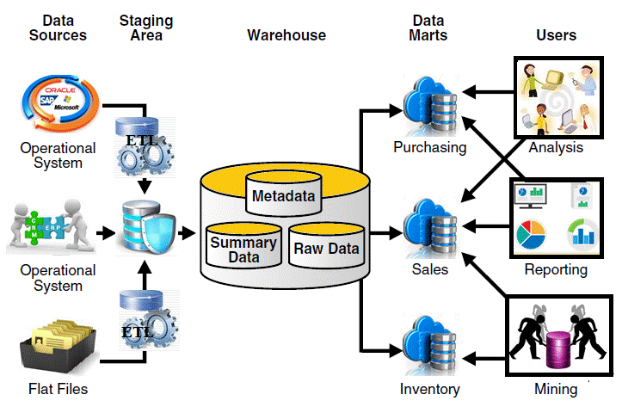
Business Intelligence
Business Intelligence: BI is the delivery of useful and accurate information to the appropriate decision makers within specific timeframe to support effective Decision making,Perfomance evaluation and Future prediction.

Slide 4
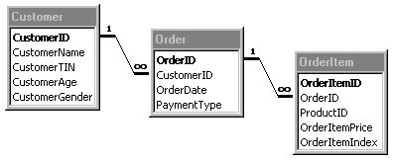
MDX
MDX, an acronym for Multidimensional Expressions, is a syntax that supports the definition and manipulation of multidimensional objects and data.
Most languages used for data definition and manipulation, such as SQL, are designed to retrieve data in two dimensions: a column dimension and a row dimension.
The following diagram illustrates a traditional relational database, used to store order information.

Slide 5
MDX
Each table represents two-dimensional data. At the intersection of each row and column is a single element of data, called a field.
The specific columns to be viewed in an SQL query are specified with a SELECT statement, and the rows to be retrieved are limited by a WHERE clause.

Slide 6
MDX
Multidimensional data, can be represented by structures with more than two dimensions.
These structures, called cubes, have multiple dimensions.
At the intersection of dimensions in a cube there may be more than one element of data, called a measure

Slide 7
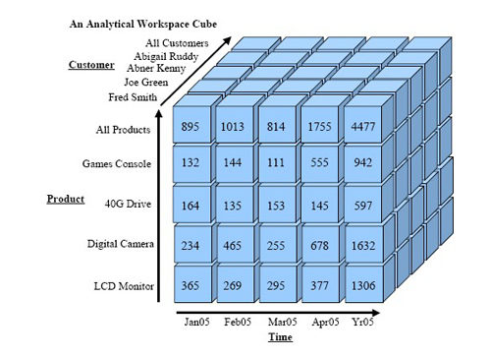
MDX
The following diagram illustrates a cube that employs three dimensions, Customer, product and Time; and one measures, Product Count

Slide 8
Members, Tuples and Sets
Members: A Members is an item in a dimension represnting one or more occurrences of data.
Member is value of dimension attribute.
Example : Jan..Feb.. March.. are the members of Month Attribute in Time Dimension.

Slide 9
Members, Tuples and Sets
Tuples: A tuple is a collection of members, each of which is selected from a different dimension.
A tuple can be composed of any and all dimensions, including, measures dimension
only one member from each dimension can exist in a given tuple.
[Dimension].[Member] or {[Dimension].[Member]} or([Dimension].[Member])
The easiest way to understand a tuple is to look at an Excel sheet. In the Excel sheet a cell is identified by A1, A2, A3, B1, B2, B3, etc.
Here A represents a coordinate from the columns and 1 represents a coordinate from the rows. We put these together and we can uniquely identify a cell in the sheet. The net effect is the same. The tuple always points to a single cell in the OLAP cube.
Example : [Date].[Calendar Year].[CY 2008]

Slide 10
Tuple dimensionality
The dimensionality of a tuple refers to the sequence or order of the members in the tuple.
The ordering of the members of the tuple is important when you define a set of tuples.
SELECT ([Measures].[Reseller Sales Amount],[Date].[Calendar Year].[CY 2008]) ON COLUMNS FROM [Adventure Works]
The tuple in the query in the above example specifies the return of the cube cell at the intersection of the Reseller Sales Amount Measure of the Measures dimension and the CY 2008 member of the Calendar Year attribute hierarchy in the Date dimension.
Notes:
When you explicitly specify a member in a tuple from more than one dimension, you must include the entire tuple in parentheses. When only specifying a single member in a tuple, parentheses are optional.
An attribute member can be referred by either its member name or its member key. In the previous example, you could replace the reference to [CY 2004] with &[2004]

Slide 11
Set
Sets are an ordered collection of 0 or more tuples
Sets are typically enclosed by curled "{ }" braces and often appear in the SELECT part of a query.
Unlike a mathematical set, an MDX set may contain duplicates. So, the same member/tuple can be in a list twice.
Example :
SELECT { ([Measures].[Tax Amount],[Date].[Calendar Year].[CY 2008]),
([Measures].[Reseller Sales Amount],[Date].[Calendar Year].[CY 2008])
}.Item(0)
ON COLUMNS
FROM [Adventure Works]
Notes:
When you explicitly specify a member in a tuple from more than one dimension, you must include the entire tuple in parentheses. When only specifying a single member in a tuple, parentheses are optional.
An attribute member can be referred by either its member name or its member key. In the previous example, you could replace the reference to [CY 2004] with &[2004]

Slide 12
MDX Query Structure
A basic MDX query uses the SELECT statement to identify a data set that contains a subset of multidimensional data.
The SELECT statement is composed of the following clauses
WITH clause (optional):
Allows calculated members or named sets to be computed during the processing of the SELECT and WHERE clauses.
SELECT clause:
Defines the axes for the MDX query structure by identifying the dimension members to include on each axis. The number of axis dimensions of an MDX SELECT statement is also determined by the SELECT clause.
FROM clause:
Names the cube that is being queried.
WHERE clause (optional):
Determines which dimension or member is used as a slicer dimension.

Slide 13
MDX Functions
Members :Members function returns a set of members within a specified dimension, level or hierarchy
Example :
  SELECT [Date].[Fiscal].[Month].Members ON 0
  FROM [Adventure Works]
  --WHERE [Date].[Fiscal Year].&[2008]
  NextMember: NextMember function returns a sibling of a specified member; the returned sibling is one position below the specified member. NextMember is synonymous with Lag(-1) and Lead(1).
  Example :
  SELECT [Date].[Fiscal Year].&[2006].NextMember ON 0
  FROM [Adventure Works]
  --WHERE [Date].[Fiscal Year].&[2008]

Slide 14
MDX Functions
Parent : Parent function returns the parent of the current member.
Example :
  SELECT [Date].[Fiscal].[Fiscal Semester].&[2008]&[1].Parent ON 0
  FROM [Adventure Works]
  --WHERE [Date].[Fiscal Year].&[2008]
Item: Returns a member from a given set based on its ordinal position within the set.
Example:
  SELECT [Date].[Fiscal].[Fiscal Year].Item(1) ON 0
  FROM [Adventure Works]
  SELECT [Date].[Fiscal].[Fiscal Year].&[2008].Children.Item(1) ON 0
  FROM [Adventure Works]

Slide 15
Thank You!

